Slide 1
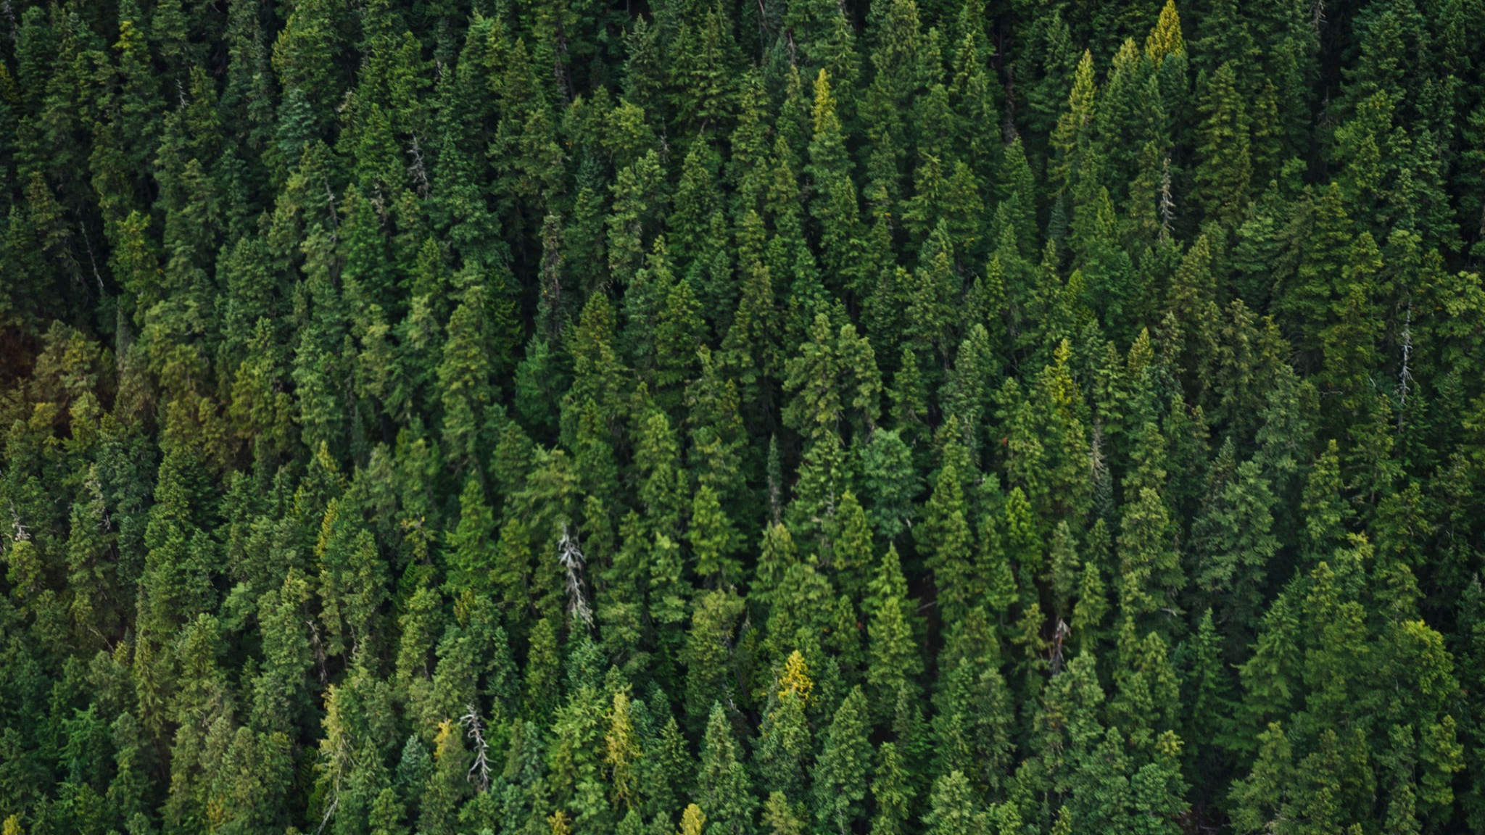
GasoLean
Roy Cheung, Atishay Jain
Chandramouli Iyer, John Yun
CS 160

Slide 2

The Team
01
Section
Section
12

Slide 3


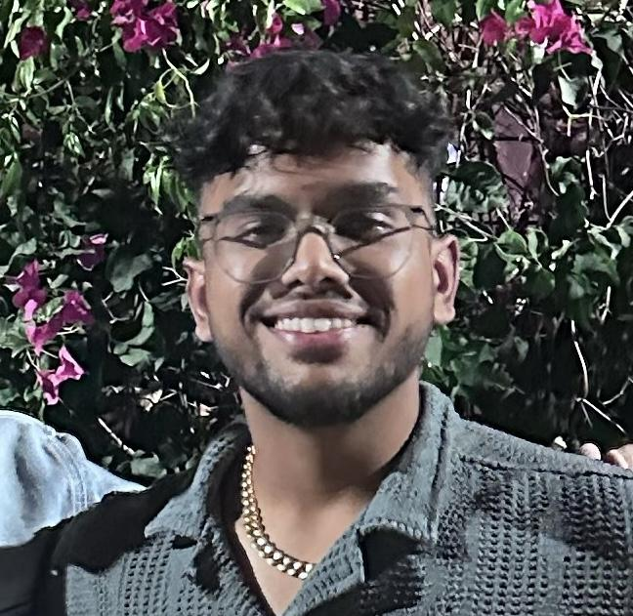
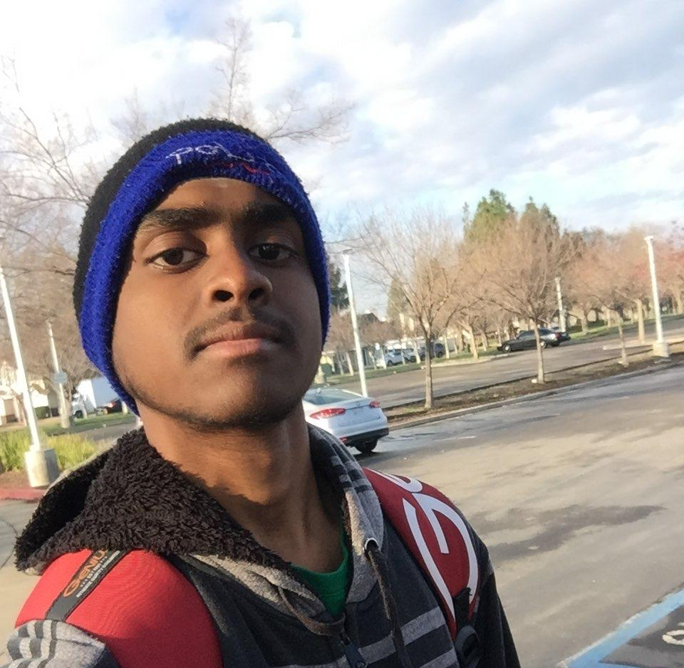
Team
CEO Front End
Front End Dev
Backend Dev
Backend Dev
Section
John Yun
Roy Cheung
Atishay Jain
Chandramouli Iyer
4th Year Student at SJSU potentially headed to graduate school to attain deeper knowledge in fields of studies such as AI, ML. Interests include playing sports, as well as watching anime
4th year CS student at SJSU. Worked directly with CEO to come up with mock-ups of our product. Then converted the design into a functional interface
4th year CS student at SJSU graduating may 2025. Have experience with front end development building portfolio and other business websites.
4th year CS Student at SJSU graduating in May 2025. Experienced with backend development and my responsibility is to build a modular and extensible backend which can easily accommodate future changes.

Slide 4
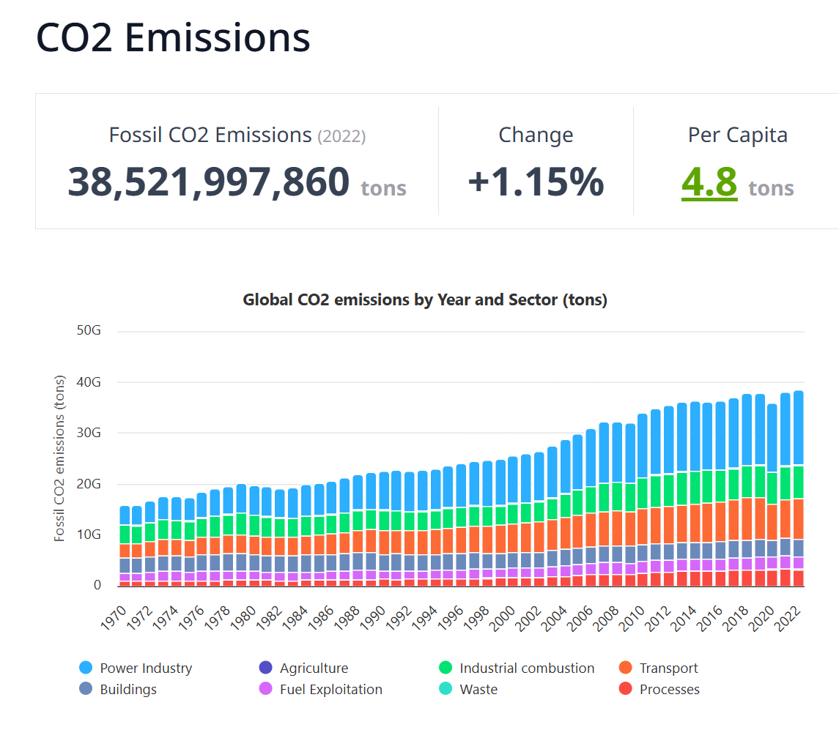
Product
Description
Problem
Opportunity
Solution
Section
Section
12
Since transportation is an integral part of our life we want to reduce the amount of emissions
“Drive economically” is the goal
Create a mobile application that tracks your fuel consumption and allows you to drive more efficiently.
Make the app user friendly, secure, and include gamification
With more drivers driving more conservatively we aim for less C02 emissions!
Global Carbon Dioxide Emissions from transportation accounts for 24% of Global emissions
road emissions from cars, buses and trucks accounts for 75%.
(only 1.4% cars in the us are EV)

Slide 5

Vision Statement
Section
Section
12
Designed for daily commuters who want to drive economically
A mobile application that tracks your real-time fuel economy
Connects directly to your car's OBD-II system for accurate data
Unlike other tracking apps, it provides:
Live vehicle diagnostics (not just estimates)
Accurate fuel usage stats
Environmental insights like CO₂ savings and fuel efficiency
Free to use
Notes:
So gasoLEAN is mainly designed for everyday drivers — people who commute regularly and want to be more fuel-conscious without needing to be a car expert.It’s a mobile app that tracks your fuel economy in real time. So as you're done driving, it shows you how efficiently you used fuel.
What makes our app different is that it connects directly to the car’s OBD-II port — the same system that mechanics use to read engine data. This lets us pull actual vehicle diagnostics, instead of just using GPS or rough estimates like most apps do.
So we’re able to give users:
Live feedback on how their car is performing,
Accurate fuel usage statistics based on actual engine data, and
Helpful environmental insights, like how much CO₂ they’re potentially saving by driving better.
And one more thing — the app is completely free to use, so anyone can start tracking and improving their driving right away.

Slide 6
Main Features of our Product
Section
Section
12
Bluetooth Connection
Mobile application that is easily able to scan and connect to your OBD_II device
Since it is wireless no need to buy a bulky expensive OBD device.
2. Tracking
Tracks your driving statistics as soon as “Start tracking” button is clicked
Statistics on the page are updated in real time
Can view your past driving records all in one place
3. User Friendly UI
Users can easily navigate through our application and easily sign in and sign out
Information is only one tap away and easily accessible

Slide 7
Main Features of our Product
Section
Section
12
4. Secure Login
Secure User Authentication
Dual verification using verification code sent by gmail
Persistent login even on app reload

Slide 8

Product Demo
Section
Section
12
Tracking
Notes:
As you can see, the details get updated in real time, after we start tracking. The device collects a lot of information from the OBD-2 device in real time. However, it’s not always perfect especially with fuel percent tracking as there isn’t a direct straightforward way to query fuel consumption. We have to estimate the fuel consumption based on commands that indirectly display it. We aim to smoothen that out after we figure out a better way to estimate how much fuel is left.

Slide 9
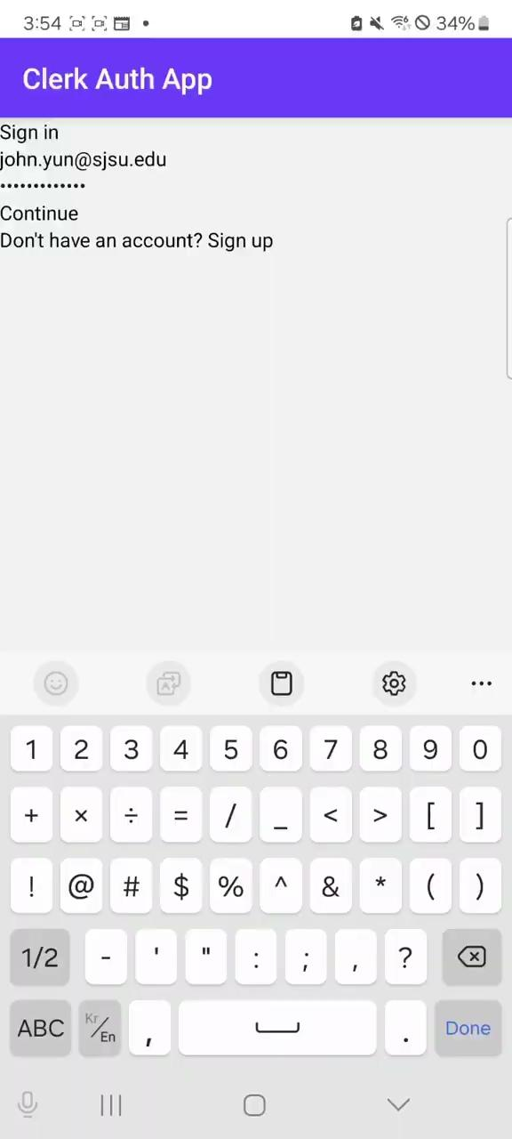
Product Demo
Section
Section
12
Authentication/ navigating the app
Notes:
Here we show off how the application looks. First, the application would need to add the OBD-2 device. Currently we support Bluetooth OBD-2 devices as they're the most popular choice with people who do buy these. We have a timeout of 5 seconds. If it isn't able to find a device within that time period. The attempt quits and we can start a scan again. After we discover a OBD-2 device, we fetch the car associated with it. Then we offer to start tracking. Once the trip is over, the user can stop tracking. The ride is stored locally. The user can see their rides on a dedicated Driving History page where the user can see their per ride statistic and overall statistics of their driving. There is also a profile page. It's not completely polished out yet, but essentially the user would login with their email. To make it even more secure, we use Clerk which would send a OTP to the email which the user would have to enter in order to create their profile. And that's about it. We are unfortunately not able to offer a live demo as this does require a physical OBD-2 device in a car.

Slide 10
What lies ahead for GasoLean…
More Functionality
Deployment on the App Store and Play Store
AI assisted driving habits
Section
⬤ Future plans include a reward system: drive better, earn points, save on gas.
⬤ We also plan to add machine learning to analyze driving habits and suggest smarter, more eco-friendly behavior.
⬤ Add support for WiFi OBD-2 devices.
⬤ With the power of power AI models, we believe that models can help you save on gas and give you tips on how to drive more economically based on your driving history
⬤ Finalize UI polish for both Android and iOS platforms.
⬤ Implement release CI/CD for seamless version rollout.
⬤ Prepare marketing assets: screenshots, descriptions, and launch plan.
Notes:
Looking ahead, we want to turn gasoLEAN into more than just a tracker—we want it to motivate people. So one of our first ideas is to build a reward system. The better and more efficiently you drive, the more points you earn. Later, these points can be redeemed as cashback, gas savings, or even perks with eco-partners.
Another thing we’re really excited about is integrating machine learning. The idea is to have the app learn from how you drive—like when you tend to accelerate hard, how long you're idling, and so on—and then give you personalized tips to save more fuel and reduce emissions. So it's not just tracking — it's actively helping you improve.
Next, we’re working on finalizing the user interface for both Android and iOS. This means tightening up the visual consistency, improving responsiveness, and making sure all interactions feel smooth and intuitive across different devices. It’s a small detail, but that last layer of polish really affects how users perceive the quality of the app.”
finally, we plan to implement a CI/CD pipeline for releases.
This will allow us to automatically build, test, and deploy app versions as we update the code — reducing manual errors and making our rollout process more reliable and scalable.
It also means we can push updates faster if we fix bugs or add features

